Slide 1
Flood frequency analysis

Slide 2
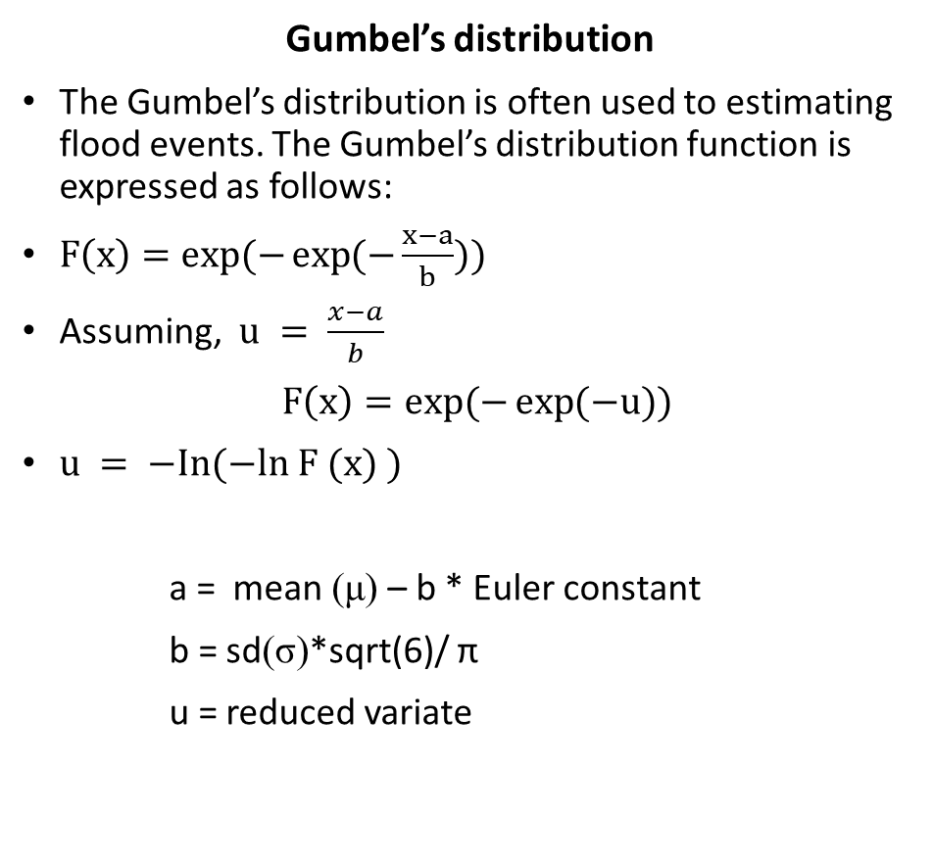
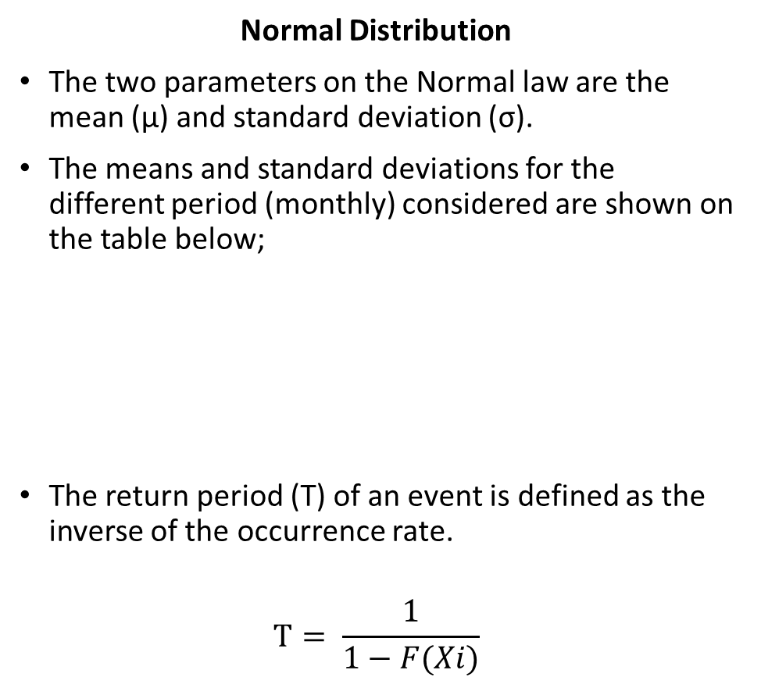
Methods
Gumbel’s distribution
The Gumbel’s distribution is often used to estimating flood events. The Gumbel’s distribution function is expressed as follows:
$F\left(x\right)=exp⁡(−\exp{(−\frac{x−a}{b}}))$
Assuming, $u = \frac{x−a}{b}$
$F\left(x\right)=exp⁡(−\exp{(−u}))$
$u = −In(−ln F (x) )$
a = mean (μ) – b * Euler constant
b = sd(σ)*sqrt(6)/ π
u = reduced variate
Normal Distribution
The two parameters on the Normal law are the mean (μ) and standard deviation (σ).
The means and standard deviations for the different period (monthly) considered are shown on the table below;
The return period (T) of an event is defined as the inverse of the occurrence rate.
$$T= \frac{1}{1−F(Xi)}$$
Monthly discharge period | Mean | Standard deviation
Over 40 years (1975-2018) | 140 | 174
1994 | 293 | 420.5
2006 - 2013 | 148.5 | 152.3

Slide 3
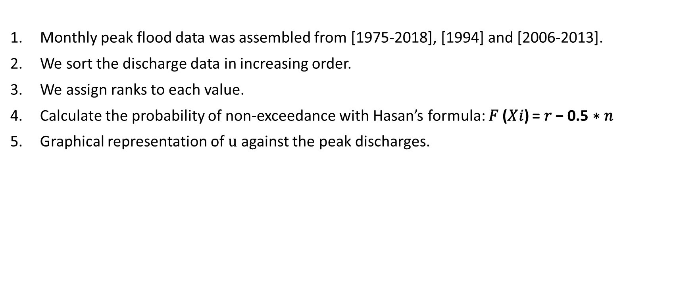
Procedure
Monthly peak flood data was assembled from [1975-2018], [1994] and [2006-2013].
We sort the discharge data in increasing order.
We assign ranks to each value.
Calculate the probability of non-exceedance with Hasan’s formula: 𝐹 (𝑋𝑖) = 𝑟 − 0.5 ∗ 𝑛
Graphical representation of $u$ against the peak discharges.

Slide 4
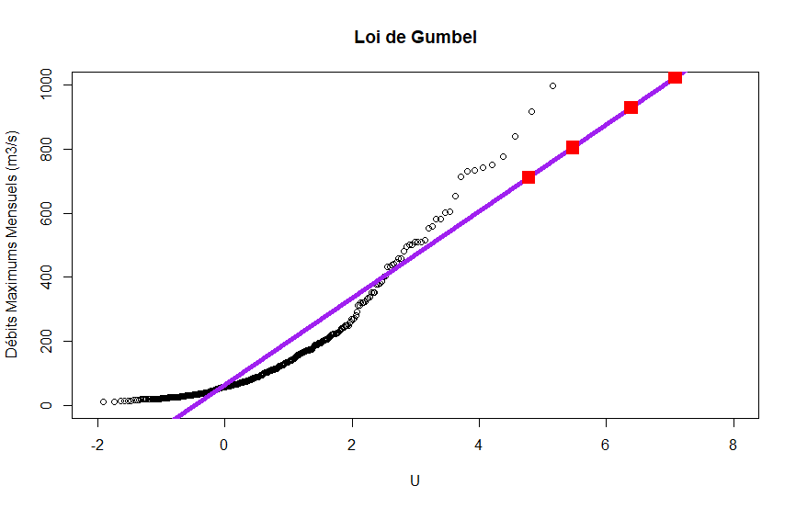
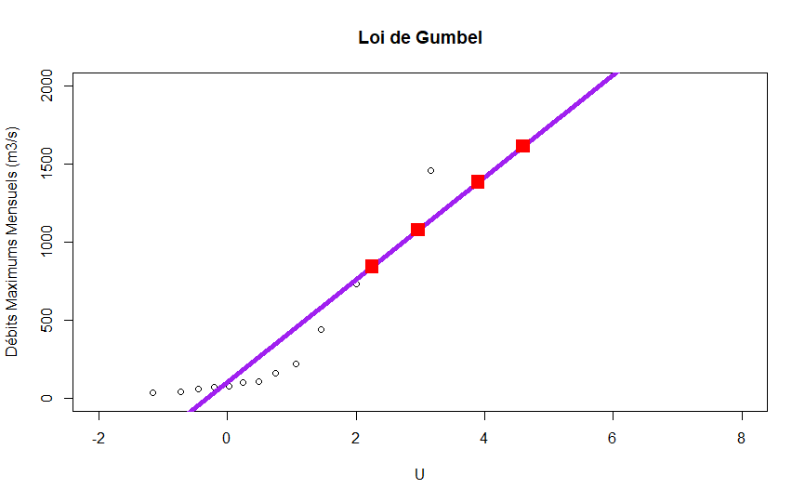
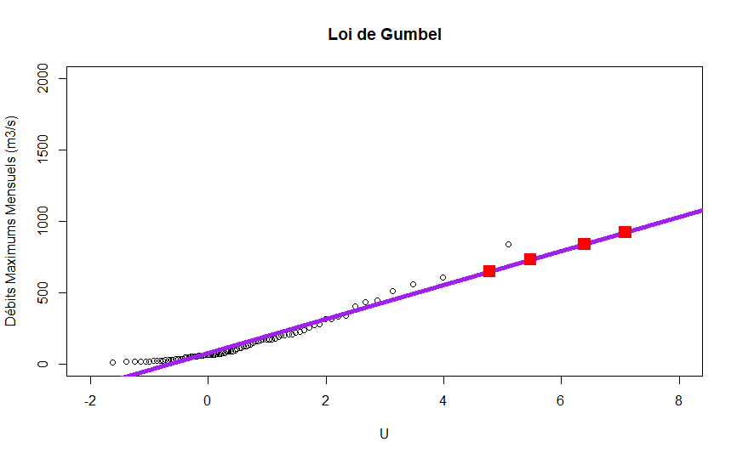
Gumbel analysis
Return period in months | Frequency | Reduced Variate(u) | Discharge (1975-2018) | Discharge (1994) | Discharge (2006-2013)
120 | 0.9916667 | 4.783311 | 710.0143 | 1672.091 | 648.3042
240 | 0.9958333 | 5.478552 | 804.2411 | 1900.058 | 730.9094
600 | 0.9983333 | 6.396096 | 928.5967 | 2200.916 | 839.9275
1200 | 0.9991667 | 7.089660 | 1022.5961 | 2428.333 | 922.3334
Gumbel (1975-2018)
Gumbel (1994)
Gumbel (2006-2013)

Slide 5
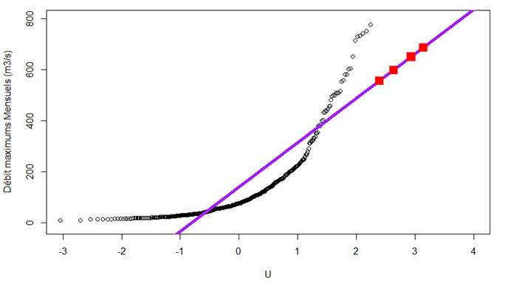
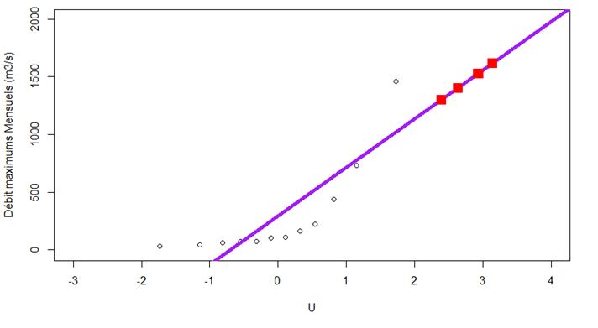
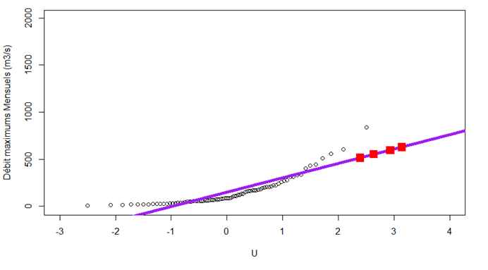
Normal analysis
Return period in months | Frequency | Reduced Variate(u) | Discharge (1975-2018) | Discharge (1994) | Discharge (2006-2013)
120 | 0.9916667 | 4.783311 | 556.0902 | 1299.696 | 513.3645
240 | 0.9958333 | 5.478552 | 598.5517 | 1402.425 | 550.589
600 | 0.9983333 | 6.396096 | 650.1678 | 1527.302 | 595.839
1200 | 0.9991667 | 7.089660 | 686.4592 | 1615.103 | 627.6543
Normal (1975-2018)
Normal (1994)
Normal (2006-2013)

